Slide 1
Web 2.0
TEHSEEN MEHRAJ

Slide 2
Web 1.0
Web 1.0 [1990 – 2000]: It is regarded as the first generation of the World Wide Web. Also known as the Syntactic web or Read only web.
Mostly, Web 1.0 was limited to searching the info and reading what’s already there. There was very little in the way of user interaction or content contribution.
It was pretty disorganized and overwhelming, and soon it came to be dominated by AOL, Compuserve, early Yahoo and other portals. These online service providers were the gateway to Web 1.0.

Slide 3
Web 2.0
Web 2.0 [from mid-2000s]: This phase was characterised by enhanced user experience and made the W3 interactive. Also known as Social Web or read-write web.
It enabled users to participate in content creation on social networks, blogs, sharing sites and more.
Search engines (Google) and social media platforms (Facebook, Twitter) driven by user-generated content disrupted the media, advertising and retail industries.
Web 2.0’s business model relies on user participation to create fresh content and the resultant data being sold to third parties for marketing purposes.

Slide 4
Web 2.0: Going Social
In 2003 there was a noticeable shift in how people and businesses were using the web and developing web-based applications.
The term Web 2.0 was coined by Dale Dougherty of O’Reilly Media in 2003 to describe this trend.
Generally, Web 2.0 companies use the web as a platform to create collaborative, community-based sites (e.g., social networking sites, blogs, wikis)

Slide 5
Web 1.0 versus Web 2.0
Web 1.0 (the state of the web through the 1990s and early 2000s) was focused on a relatively small number of companies and advertisers producing content for users to access (some people called it the “brochure web”).
Web 2.0 involves the users—not only do they often create content, but they help organize it, share it, remix it, critique it, update it, etc.
One way to look at Web 1.0 is as a lecture, a small number of professors informing a large audience of students. In comparison, Web 2.0 is a conversation, with everyone having the opportunity to speak and share views.
Companies that understand Web 2.0 realize that their products and services are conversations as well.

Slide 6
Architecture of Participation
Web 2.0 is providing new opportunities and connecting people and content in unique ways.
Web 2.0 embraces an architecture of participation—a design that encourages user interaction and community contributions.
The user, are the most important aspect of Web 2.0
Several popular blogs now compete with traditional media powerhouses, and many Web 2.0 companies are built almost entirely on user-generated content.
For websites like Facebook, Twitter, YouTube, eBay and Wikipedia, users create the content, while the companies provide the platforms on which to enter, manipulate and share the information.
These companies trust their users—without such trust, users cannot make significant contributions to the sites.

Slide 7
Search Engines and Social Media
Search engines, including Google, Microsoft Bing, and many more, have become essential to sifting through the massive amount of content on the web.
Social bookmarking sites such as del.icio.us allow users to share their favourite sites with others. Social media sites such as DiggTM enable the community to decide which news articles are the most significant.
The way we find the information on these sites is also changing—people are tagging (i.e., labeling) web content by subject or keyword in a way that helps anyone locate information more effectively.

Slide 8
Content networks
A content network is a network of sites that provide content (text, videos, audio, etc.).
The content network is the collection of sites.

Slide 9
User generated content
User-generated content is any content that’s created by users of an online platform rather than its owners, whether that content is text, videos, photos, or something else.
Most social media platforms rely on user-generated content, but so do many other online spaces like websites, online forums, and online communities.

Slide 10
Pros of user-generated content
Scale content creation fast
Bring in diverse voices and points of view
Increase organic reach and conversation
Cons of user-generated content
Need for moderation
User-generated content examples
Community members in a Mighty Network share posts with their community and respond to others’ posts.
Posting pictures of your cat on Instagram
Writing a blog post on Medium
Creating videos on YouTube.

Slide 11
blogging
A blog is a type of website where the owner (or author) writes about their experiences, opinions, thoughts, or anything else they want to share with the world. The term “blog” is a contraction of the words “weblog.”
In simple words, a blog is a website where people can post their thoughts and opinions on a variety of topics. A blog is an online journal where you can share your expertise and ideas.
A blog MOSTLY focuses on written content. Blog posts are usually written in an informal or conversational style.
A blog can be about any topic, but most are focused on a specific niche, such as fashion, beauty, lifestyle, food, travel, parenting, finance, etc.

Slide 12
How blogging works
In order to start blogging, one will need to create an account on a blogging platform such as WordPress or Blogger.
Once we have set up an account, you can start writing posts and publishing them online.
We can also add pictures and videos to our blog and share links to our posts on social media sites such as Facebook and Twitter.

Slide 13
tagging
Tags are simple pieces of data that describe information on a document or web page. Tags provide details about an item and make it easy to locate related items that have the same tag.
Tags are used to label Internet content with additional information. They’re used in different ways, depending on the context and the particular channel. For example, blog posts or posts including photos on social media channels like Facebook and Twitter can all be tagged.
Tags can be used on any digital object. Any information that can be stored or referenced on a computer can be tagged. Tagging may be used for the following:
Digital photos: Many photo management programs offer tag support.
Address books: Add a field for tags in your address books. Then, whenever one want to send a message to our entire family, search on the "family" tag.
Web pages and blogs: Many blogs use tags.
Social media and folksonomies: By allowing other people to tag your site with their own tags, one can find out what they think of our pages.

Slide 14
Tagging
The tagging process involves using labels to provide content with additional information (using a particular set of keywords).
Tagging is primarily used to make information easier to find or link to, and there’s a difference between blog tags and social media tags.
Some sites also incorporate tag clouds. Here the keywords are displayed in larger or smaller sizes depending on their frequency and popularity. A site’s tag cloud can therefore indicate, for example, which topics and terms will appear most often.

Slide 15
Blog Tags
A blog post will often include relevant keywords, and clicking on a tag will then display all content grouped with, and related to, that particular topic. Posts connected to a particular keyword will appear in a list.
When blog tagging, the author adds appropriate tags to the content when uploading it to a content management system. Because all articles on the system will use tags, anyone using several authors to write blog articles should arrange and agree a unified spelling protocol for all tags.
Social Tagging
Tags are also used on social media channels such as Facebook and Twitter. On Facebook, for example, it’s possible to highlight other Facebook users in posts or photos. By tagging another Facebook user, a link is created, and through that link, the post or picture may be added to the other Facebook user’s Timeline.
Tags on Twitter
As with Facebook, it’s also possible to tag other users on Twitter’s microblogging service. This is highlighted in tweets by putting an @ symbol before the username, and Twitter now also allows us to tag other people in photos.
In addition, Twitter is also known for its use of the hashtag. Although many other social media channels like Facebook, Pinterest, Instagram, LinkedIn and Google+ now also allow the use of hashtags, it originated on Twitter.
A hashtag on Twitter is a hash placed before a certain keyword, which may include both alphabetical and numeric forms. Hashtags can be positioned within a tweet or at the end of a tweet and are used to aggregate information about a topic. To help users follow the latest trends and topics, related tweets are collected together under the same hashtag. When a new hashtag is picked up by other Twitter users, it can soon spread virally across the Internet.

Slide 16
Pros And Cons of Blogging
Pros of blogging:
One of the biggest advantages of blogging is that it helps to make money. There are a number of ways one can monetize the blogs such as selling advertising, selling products or services.
Blogging allows us to share your ideas and thoughts with the world. It allows us to connect with other like-minded people and build a community of followers around our blog.
Blogging can help us build our personal brand and establish ourselves as an expert in our industry.
It can also be a great way to drive traffic to our website and generate leads for our business. By optimizing our blog posts for search engines, we’ll be able to get more people to our site and increase the chances of them doing business with us.
Finally, blogging can help us build and improve your skills such as writing, coding, networking, etc.
Cons of blogging:
One of the biggest disadvantages of blogging is that it takes time and effort to build a successful blog.
It can be difficult to come up with fresh content on a regular basis, and it can be even harder to promote our blog and get people to read it.

Slide 17
Difference between website & blog
BLOG | WEBSITE
A blog is a type of website where content is presented in a reverse chronological order. | Static/dynamic in nature
Content is in the form blog posts, updated regularly | Not updated regularly
A blog can be on a website or on any blogging platform
Earlier started as personal, later companies adopted it as it drives traffic | Content is not updated regularly. Hence informational approach is less

Slide 18
Rich Internet Applications (RIAs)
Rich Internet/Media Applications, is considered as RIAs. RIAs are the online apps which has the ability to use the rich graphics interface and functionality of a desktop software in a web browser.
A rich Internet application (RIA) is a Web application designed to deliver the same features and functions normally associated with desktop applications. RIAs generally split the processing across the Internet/network divide by locating the user interface and related activity and capability on the client side, and the data manipulation and operation on the application server side.
An RIA normally runs inside a Web browser and usually does not require software installation on the client side to work. However, some RIAs may only work properly with one or more specific browsers.
For security purposes, most RIAs run their client portions within a special isolated area of the client desktop called a sandbox. The sandbox limits visibility and access to the file and operating system on the client to the application server on the other side of the connection.

Slide 19
This approach allows the client system to handle local activities, calculations, reformatting and so forth, thereby lowering the amount and frequency of client-server traffic, especially as compared to the client-server implementations built around so-called thin clients.
One distinguishing feature of an RIA (in contrast to other Web-based applications) is the client engine that intermediates between the user and the application server. The client engine downloads when the RIA launches. The engine can be augmented during subsequent operation with additional downloads in which the engine acts as a browser extension to handle the user interface and server communications.

Slide 20

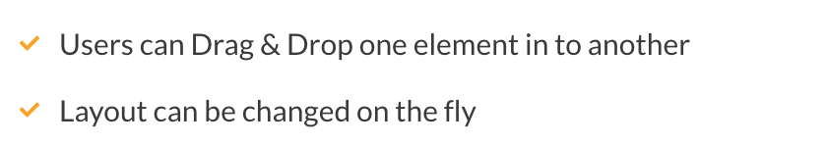

Slide 21
Content Updates: Traditional web pages are loaded once and for every changes the whole page needs to be reloaded to post and get result from server. Even with high end internet connection one has to wait for the complete page to reload every time a query is made to the server. But in RIAs, we have Asynchronous method to communicate with server. That means it doesn’t wait for the result to come from server. It is processed simultaneously so that user can perform any other actions as well. We have various methods to achieve this by using Real Time Messaging Protocol(RTMP), Real time streaming, Web Services and many other methods available.
Offline Usage: With RIAs, it is even possible to work in offline mode i.e. if the internet connection goes off in between then the RIA can be built in such a manner that it will retain the state and all the changes in local environment and as soon as the internet connection is back it will push the changes to server. This will avoid user from doing the same changes again as in traditional web apps. This feature comes in very handy when we are in a place without internet or in a travel. We can just do the necessary changes and these will be synced with server once we have internet connection.
Design Maintainability: Since, RIAs are wrapped in to a plug-in. All the designs and functionalities are same across platform and devices as compared to traditional web pages. For instance, if we have a weather widget created as RIA then it will have same look & feel and functionality across all platforms and devices since it is going to have a single code base.
Performance: Performance is the main factor where RIAs considered compared to traditional pages. RIAs can perform much better based on the application built and network capabilities.
Real Time Feedback: Since RIAs use Asynchronous method and doesn’t reload the web page for every communication to server. The results are shown as and when required and it avoids user from waiting long time for page load to see the results from server.

Slide 22
Disadvantages/Drawbacks in RIAs:
Plug-in based: Since RIAs rely on a plug-in to be displayed in browser. So, the user needs to have the respective plug-in in order to have the particular RIA displayed. This might not be good for no-wise users who don’t know anything. But nowadays, more than 90 percent of computers have plug-ins like Adobe Flash Player which is used to display the RIA created using Adobe Flash/Flex/ActionScript.
Cost & Time: Developing RIAs are bit expensive and time consuming as compared to traditional web apps.
Compatibility: RIAs can be built in such a way that it can be displayed and work properly even in very low end machines. But still this is a point to be considered where it will fail in some of the low end machine as the required plug-in will not be supported

Slide 23
Web services
A web service is a generic term for an interoperable machine-to-machine software function that is hosted at a network addressable location.
A web service has an interface, which hides the implementation details so that it can be used independently of the hardware or software platform on which it is implemented, and independently of the programming language in which it is written.
This independence encourages web service based applications to be loosely coupled, component-oriented, cross-technology implementations.
Web services can be used alone or with other web services to carry out a complex aggregation or a business transaction.

Slide 24
examples
Location-Based Services Applications
Popular location-based services apps include but are not limited to:
Assistive healthcare systems
Contextualizing learning and research
Games directly influenced by the real-life movements of the player’s avatar
Location-based mobile advertising
Querying the nearest business
Recommending nearby social events
Receiving alerts, such as traffic jams or Amber Alerts
Recovering stolen assets with active RF
Sending a mobile caller's location during an emergency call
Tracking a NASA lunar lander
Tracking people on a mobile map application
Turn-by-turn navigation

Slide 25
Location-Based Services
Location-based services (LBS) refers to services that are based on the location of a mobile user as determined by the device’s geographical location.
LBS applications provide services and information that are most relevant to the user at that location.
Location-based services combine geospatial technologies, information and communication technologies, and the Internet to provide targeted information to individuals based on their geographic location in real-time.
Mobile location-based services consist of the location-based services software, a content provider to provide geographic-specific information, an end user’s mobile device, a positioning component, and a mobile network to transmit the data.

Slide 26
How Do Location-Based Services Work?
One method for determining the geographic location of a mobile user is with the use of the mobile phone network and the cell ID, which can pinpoint the location of the base transceiver station. Another method is the use of GPS satellites, which is a more accurate method as many smartphones are built with GPS receivers. Short-range positioning beacon location based services, such as WiFi or Bluetooth location based services, may also be used to geolocate mobile users using indoor location-based services.
Once the geographic location of a user has been determined, mobile app location-based services are categorized as push-based, such as marketing information being displayed to a user based on their location, or pull-based, in which the user requests location-based information, such as querying “restaurants open near me.”

Slide 27
Types of Location-Based Services
There are four primary types of location-based services: maps and navigation; tracking services; information services; and applications.
Maps and Navigation: maps, routing, and assisted navigation services
Tracking Services: real-time traffic updates, vehicle tracking, friends and family finder
Information Services: local contacts search (White/Yellow Pages), city guides, user generated content ‍
Applications: context advertising, social networking

Slide 28
Web 3.0: The future of internet
Web 3.0 is the next version of the internet, where services will run on blockchain. It is a decentralised internet that runs on a public blockchain, which is also used for cryptocurrency transactions.
It will be permissionless and democratic. For instance: Twitter will not be able to censor posts and Facebook will not be able to maintain a database of billions of users that can be potentially used to influence elections.
In a Web 3.0 universe, people will control their own data and will be able to move around from social media to email to shopping using a single personalized account, creating a public record on the blockchain of all of that activity.
All data will be interconnected in a decentralized way, unlike the current generation of the internet (Web 2.0), where data is mostly stored in centralized repositories.
– Three key features of Web 3.0 are: Ubiquity, Semantic Web, Artificial Intelligence and 3D Graphics.

Slide 29
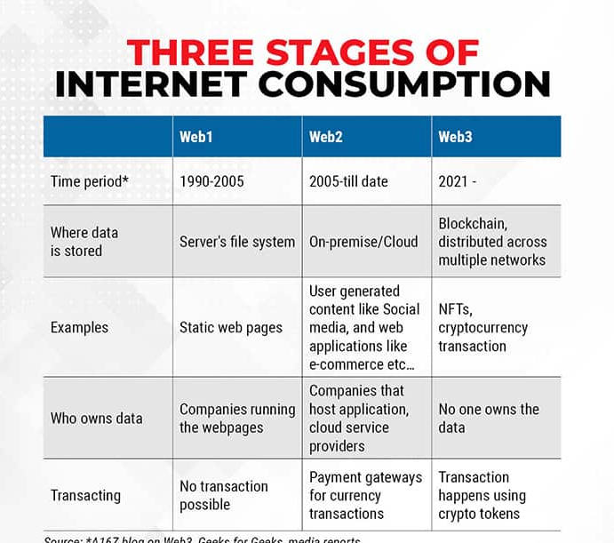
Web 3.0 [yet to arrive]: It is the next stage of the web evolution. It would make the internet more intelligent, or process information with near-human-like intelligence through the power of AI systems.

Slide 30
Why we need Web 3.0?
Loss of privacy: Presently, a huge amount of data is generated when consumers search, shop or upload videos and pictures. All this data is stored in the servers of the companies that the people interact with. This means that intermediaries become custodians of user data and profit from it via advertising. For such companies, the more time consumers spend creating content, the more data the company can collect, helping it to improve its AI algorithm and its advertising engine, a key revenue model for the company.
This gives rise to issues of privacy, wherein user data is shared for profit without their consent.
Data ownership: Presently, only centralized repositories are the ones that own user data and profit from it. In Web 3.0, users can own and be properly compensated for their time and data.
Plagiarism: Plagiarism is widespread online. It’s very easy to copy original content and build a following around it on social media. Those who copy content get compensated way more than the original content creator. Plagiarism makes it harder for creators to get adequately compensated. Web3 might help address that issue. The transparent nature of blockchain makes it easy for anyone to track the originator of content.

